Slide 1






PRESENTATION 2026
Student Name
Student Email
Isha Sajwan
ishasajwan05@gmail.com
Mentor Name
Umamaheshwari

Slide 2

Outline
Abstract of the Project
Problem Statement
Proposed Solution
System Architecture
Live Demo of the Project
Embedded Video of Project
Conclusion
Future Scope

Slide 3

Abstract
Project Overview: A data-driven analysis of bank customer demographics and account behavior to identify patterns related to customer attrition.
Objective and Purpose: To calculate key churn metrics and identify specific risk factors to help the bank improve customer retention strategies.
Tools and Technologies: Developed using Python for data cleaning and Microsoft Excel for creating the executive dashboard and in-depth analysis.
Expected Outcomes: Clear visibility into churn rates across different regions and the identification of high-risk customer segments.
Key Highlights: Discovery of significant geographic variance, such as Germany's churn rate being double that of France.

Slide 4

Problem Statement
Core Problem: High customer turnover and the inability to pinpoint exactly why customers are leaving the bank.
Significance: Uncontrolled churn leads to significant revenue loss and increased costs for acquiring new customers.
Affected Parties: Bank management and customer success teams focused on long-term growth and stability.
Existing Limitations: General reports often miss hidden correlations, such as the 32% churn rate specific to the German market.
Scope: Analysis is strictly focused on account behavior and demographics across France, Germany, and Spain.

Slide 5

Proposed Solution
Proposed Solution: An automated diagnostic dashboard that identifies churn patterns across geography, credit scores, and age demographics.
Problem Resolution: It converts raw data into actionable insights, allowing management to visualize exactly where churn is highest, such as in Germany.
Methodology: The process involved cleaning raw datasets, performing a segmented churn analysis, and creating an executive-level summary report.
Tools: Python was utilized for data preparation and cleaning, while Excel served as the primary tool for visualization and dashboarding.
Key Benefits/Innovation: Unlike static reports, this approach provides a segmented view that highlights specific regional vulnerabilities, offering more precise targeting for retention.

Slide 6
System Architecture
Data Input / Source
Processing / Analysis
The project utilizes a raw dataset containing customer IDs, credit scores, and account details across multiple regions to perform retention analysis.
The data was processed using Python to remove duplicates and handle nulls, then organized in Excel for pivot-based geographic and demographic analysis.
AI / Tool Integration
Output / Dashboard
Excel is used to host the data and create the Executive Dashboard, while AI tools assisted in generating the underlying Python cleaning scripts.
The final output is a multi-sheet Excel workbook featuring an executive dashboard and in-depth churn analysis reports.

Slide 7
Live Demo of Project
Here's the list of some demo features of the project:
Demo 1
Demo 2
Demo 3
Demo 1 showcases an interactive dashboard that highlights geographic churn hotspots, specifically identifying a critical 32% attrition rate in Germany.
Demo 2 features a deep-dive analysis comparing active versus inactive members to pinpoint service engagement levels that lead to higher customer retention.
Demo 3 illustrates the relationship between credit scores and account balances, revealing how financial health impacts a customer's decision to exit.

Slide 8
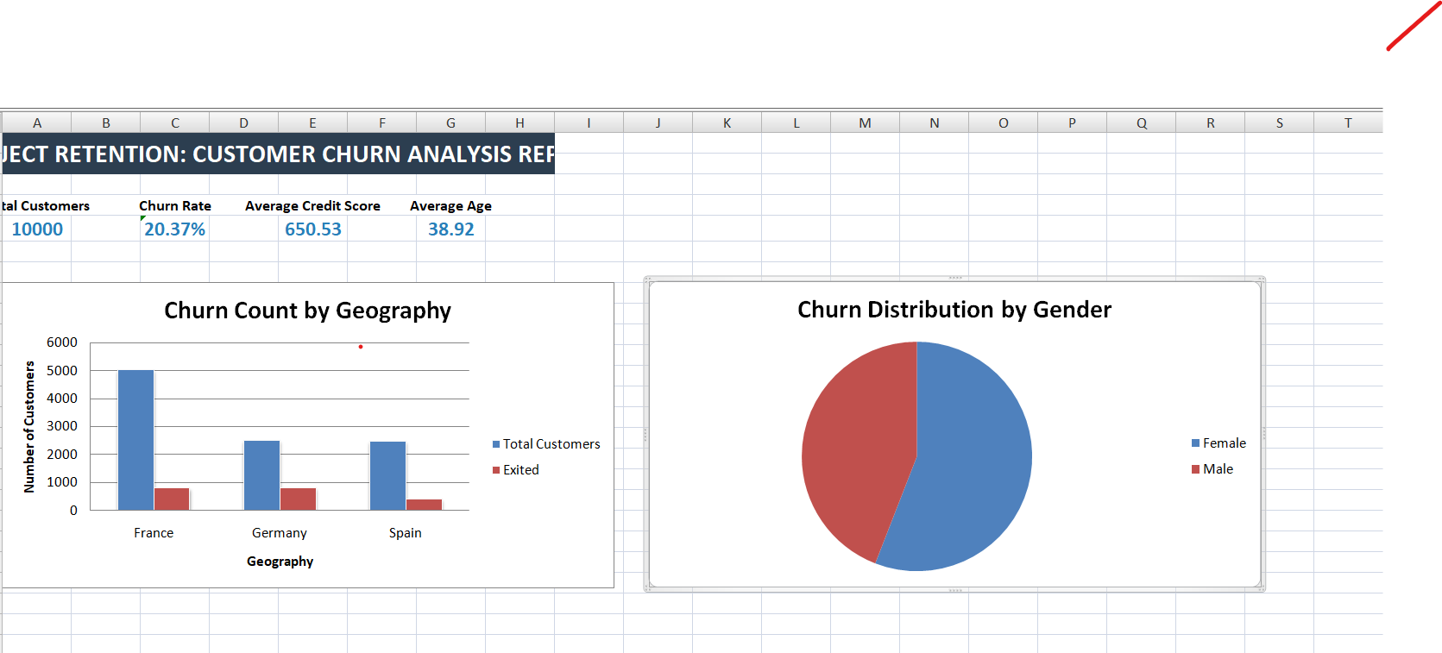

Slide 9

Conclusion
The project successfully identified key churn drivers, revealing a high 32.4% churn rate in Germany and demonstrating that active membership significantly improves retention. By achieving the objective of converting raw customer data into actionable insights, this work adds value to the banking domain by providing a targeted framework for reducing attrition and protecting revenue.
CONCLUSION

Slide 10

Future Scope
Predictive Modeling: Implement machine learning algorithms to predict individual customer churn probability based on historical patterns.
Dynamic Dashboards: Transition from static Excel reports to a live Power BI or Tableau dashboard for real-time monitoring of churn KPIs.
Segment Expansion: Broaden the research scope beyond France, Germany, and Spain to include a global dataset for broader market insights.
Integration: Connect the analysis tool directly to the bank’s CRM database to automate data cleaning and provide immediate retention alerts.

Slide 11
Thank You
AICW Fellowship | Student Project Presentation 2026
LinkedIn | Edunet Foundation

